Slide 1
Portfolio Optimization Progress Report:
11/3/2024
TANG Jiarui | 21016753

Slide 2


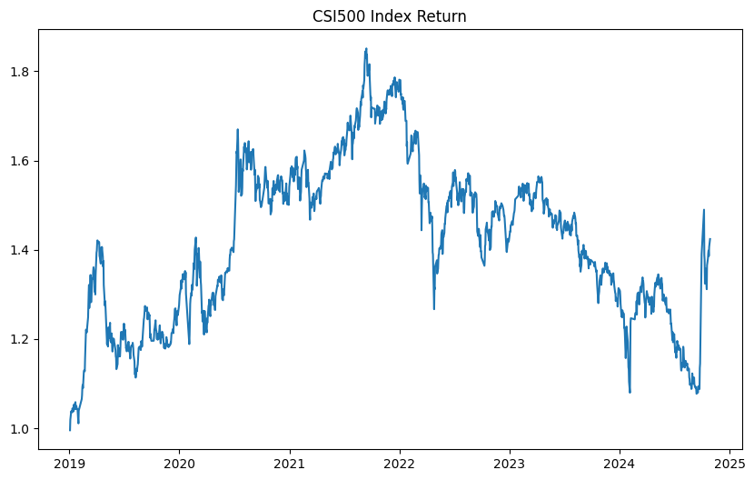
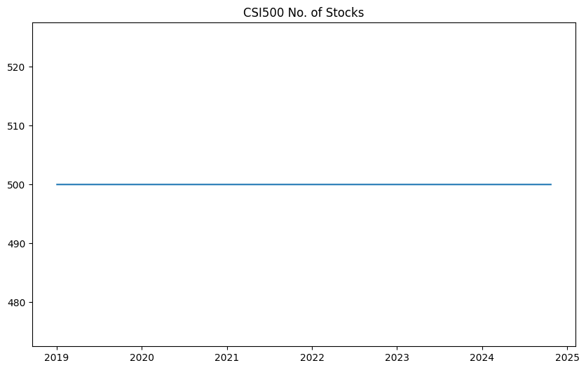
Sample
Overview
Optimization
Object
Backtest
Setting
Backtest
Results
Future plan
and Improvement
Sample Overview
CSI500
Sample Data
Index Performance
CSI 500 constituents
500 stocks each day
2019/01/01 – 2024/10/23
968 stocks covered

Slide 3
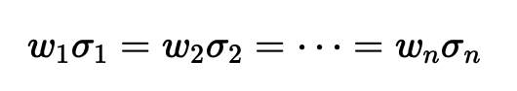
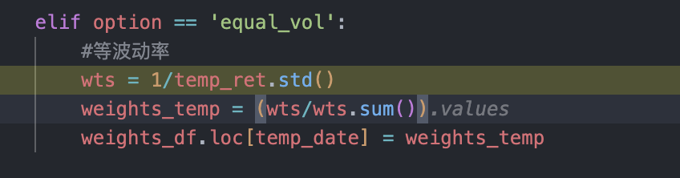
Sample
Overview
Optimization
Object
Backtest
Setting
Backtest
Results
Future plan
and Improvement
Default Constraints
sum of weights = 1.
0 < weight of each stock < 0.15
Optimization Object
Equal Volatility
Calculate current volatility by standard deviation of historical returns
The weight of each stock is inversely proportional to its volatility.
Adjust total sum of weights to be 1

Slide 4
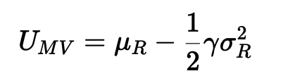
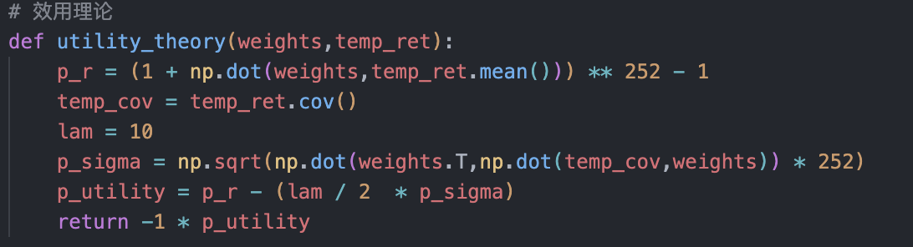
Sample
Overview
Optimization
Object
Backtest
Setting
Backtest
Results
Future plan
and Improvement
Optimization Object
Utility Theory
μ​ and σ represent the mean and variance of the portfolio‘s return, respectively, and γ represents the investor’s risk aversion coefficient.

Slide 5
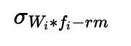
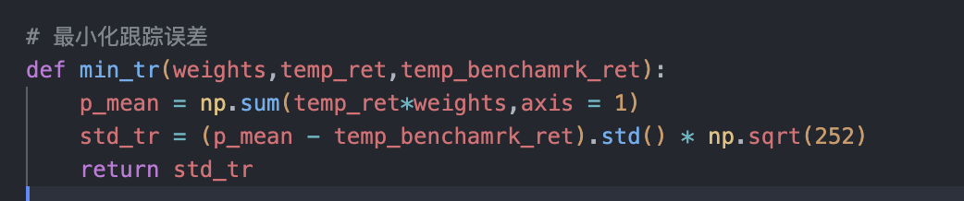
Sample
Overview
Optimization
Object
Backtest
Setting
Backtest
Results
Future plan
and Improvement
Optimization Object
Tracking Error
Calculate daily return difference of portfolio return and index return
The tracking error is the standard deviation of return difference

Slide 6


Sample
Overview
Optimization
Object
Backtest
Setting
Backtest
Results
Future plan
and Improvement
Backtest Setting
Backtest Procedure
Parameter Settings
10, 000, 000 cash at the beginning
Choose top 20 stocks with predicted factor values
Calculate optimal weight via optimization in day before adjustment date
Calculate stock value to be traded
Update cash and stock value account
Adjustment period: adjust position every 20 days
Lot size: minimum shares of stock each trade.
Trade price: adjVWAP

Slide 7
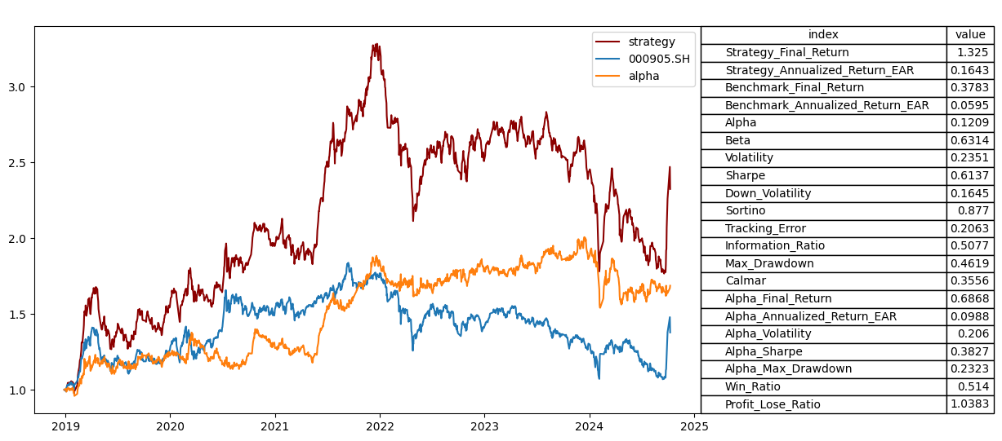
Sample
Overview
Optimization
Object
Backtest
Setting
Backtest
Results
Future plan
and Improvement
Backtest Results
Equal Weight

Slide 8
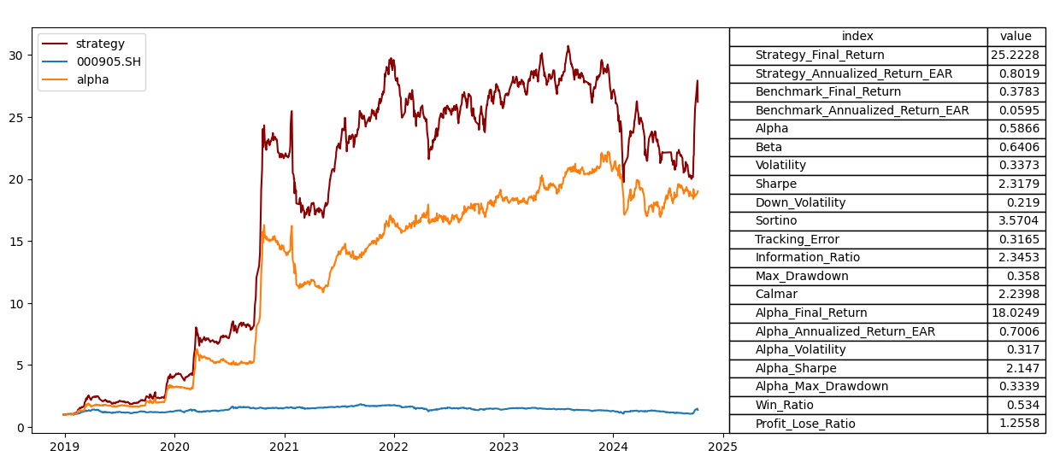
Sample
Overview
Optimization
Object
Backtest
Setting
Backtest
Results
Future plan
and Improvement
Backtest Results
Equal Volatility

Slide 9
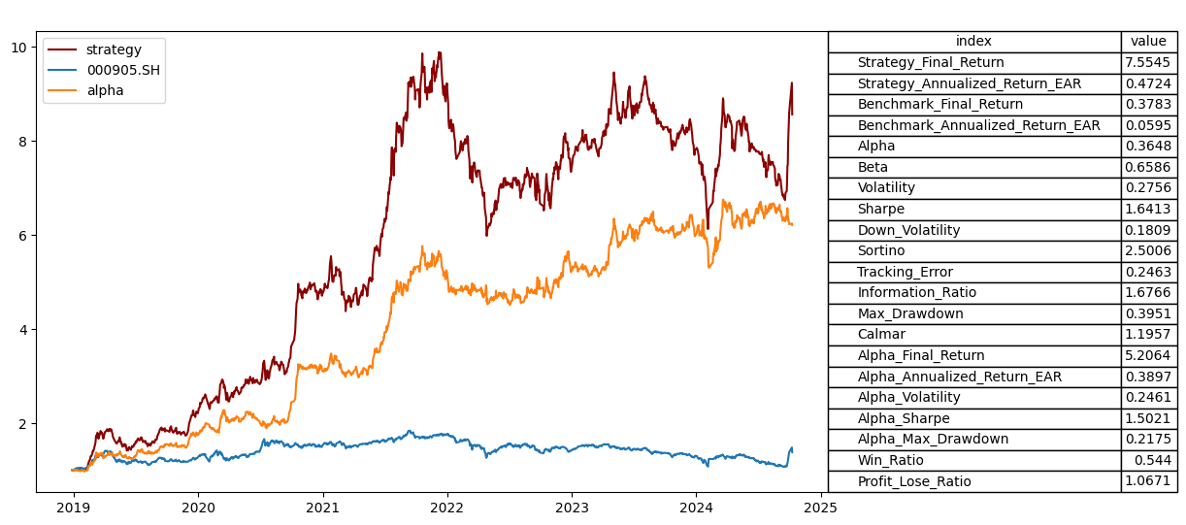
Sample
Overview
Optimization
Object
Backtest
Setting
Backtest
Results
Future plan
and Improvement
Backtest Results
Utility Theory

Slide 10
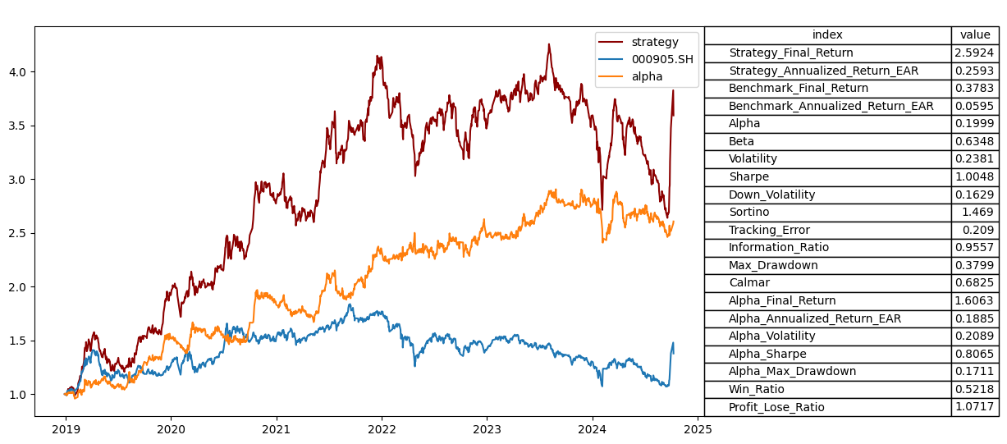
Sample
Overview
Optimization
Object
Backtest
Setting
Backtest
Results
Future plan
and Improvement
Backtest Results
Tracking Error

Slide 11
Sample
Overview
Optimization
Object
Backtest
Setting
Backtest
Results
Future plan
and Improvement
Backtest Results
Implication
The XGBoost model’s predicted factors have a strong ability to filter good stocks.
Portfolios after optimization show better returns than the index.
Portfolios have high volatility and tracking errors, even when the objective function is to minimize tracking error.
Portfolios have a high turnover ratio, which may lead to high transaction costs.
The underlying return-driven factors are “styles.” This means that simply fitting the previous returns does not reveal the “styles” within (this is also true if we choose all index constituents for trading).

Slide 12
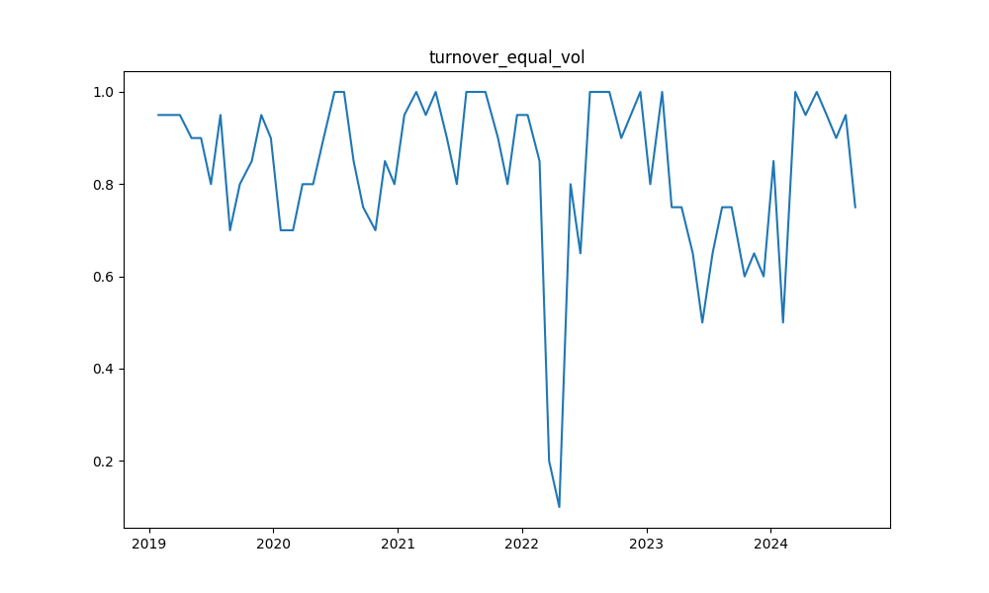
Sample
Overview
Optimization
Object
Backtest
Setting
Backtest
Results
Future plan
and Improvement
Backtest Results
Turnover Ratio (choosing top 20 stocks)

Slide 13
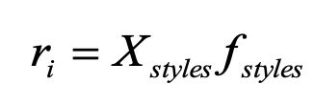
Sample
Overview
Optimization
Object
Backtest
Setting
Backtest
Results
Future plan
and Improvement
Backtest Results
What is Barra Factor
CAPM: Expected Return = Risk-Free Rate + (Beta * Marke Risk Premium)
Size: The extent of a company's large-cap status.
Non-linear Size: The degree to which a company's size is at a medium level.
Book-to-Price: The ratio of book value to market value.
Growth: A combined measure of net assets, profit, and earnings expectations.
Momentum: Short-term momentum over 3 months.
Earning Yield: The ratio of earnings to market value.
Leverage: The use of leverage by a listed company.
Liquidity: Returns due to differences in trading volume and frequency.
Beta: The correlation efficiency between a company and the stock index.
Volatility: Uncertainty relative to market deviation.

Slide 14
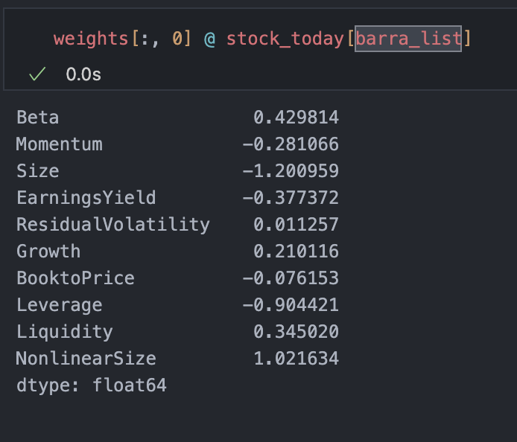
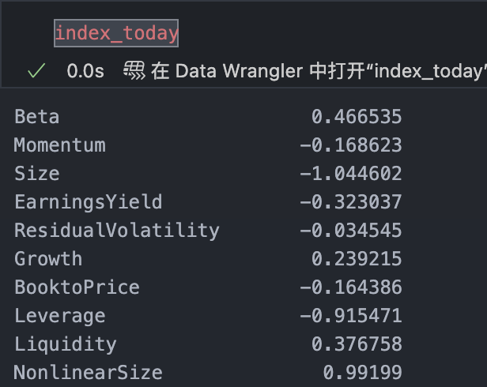
Sample
Overview
Optimization
Object
Backtest
Setting
Backtest
Results
Future plan
and Improvement
Backtest Results
Barra and industrial constraints effect on tracking error
Barra exposure relative difference <=0.1, 0.3, 0.5
Daily turnover ratio <= 0.15
Objective: maximize sum of weighted prediction score(encourage the optimizor to choose stocks with high predicted score)

Slide 15
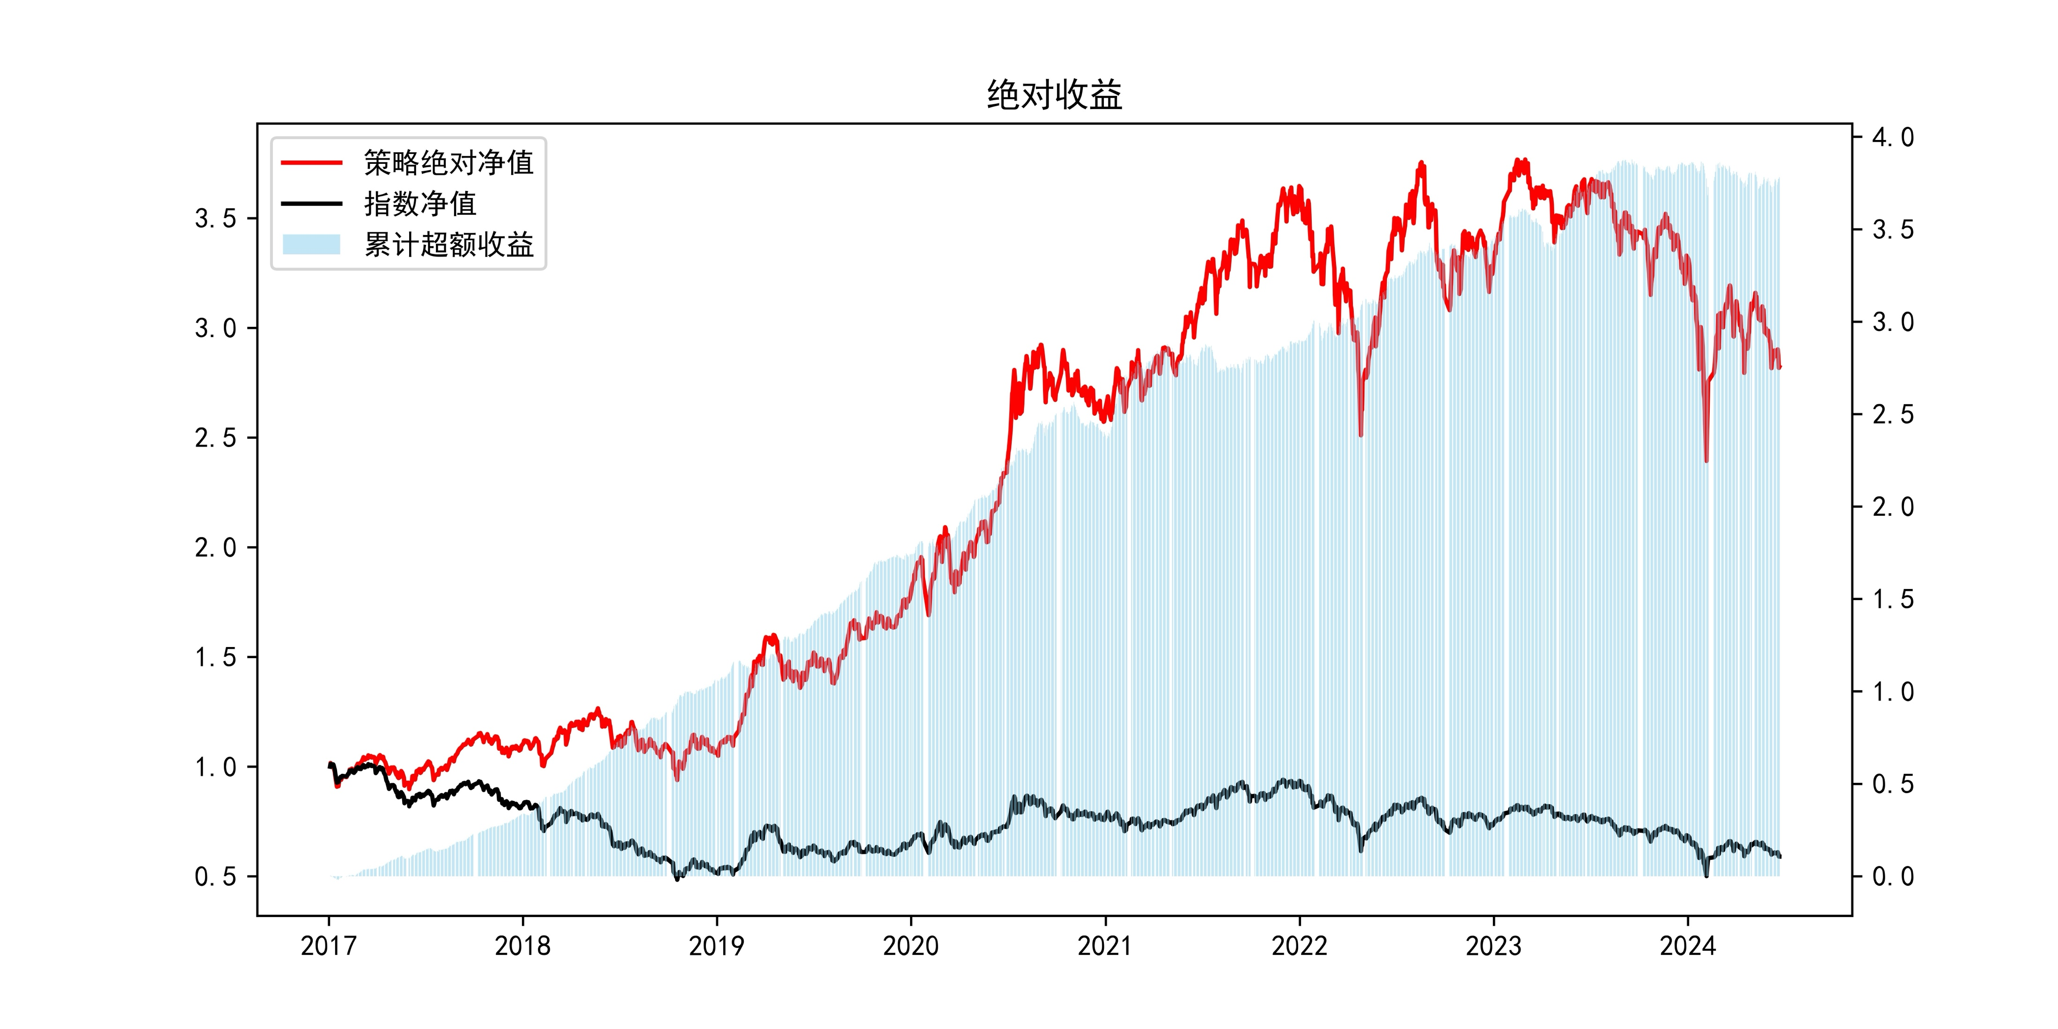
Sample
Overview
Optimization
Object
Backtest
Setting
Backtest
Results
Future plan
and Improvement
Backtest Results
Barra and industrial constraints effect on tracking error
Barra exposure relative difference <=0.1

Slide 16
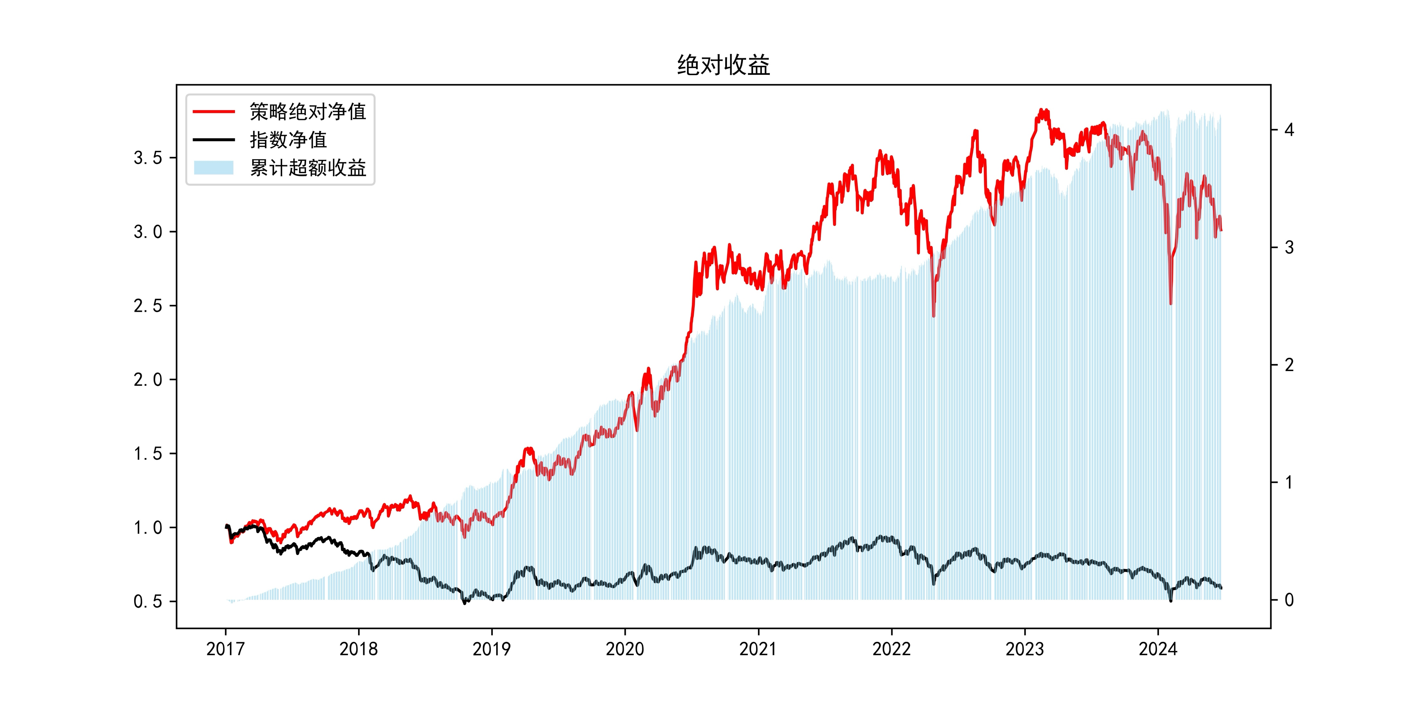
Sample
Overview
Optimization
Object
Backtest
Setting
Backtest
Results
Future plan
and Improvement
Backtest Results
Barra and industrial constraints effect on tracking error
Barra exposure relative difference <=0.5

Slide 17
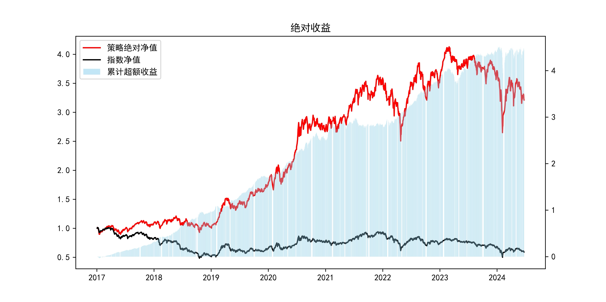
Sample
Overview
Optimization
Object
Backtest
Setting
Backtest
Results
Future plan
and Improvement
Backtest Results
Barra and industrial constraints effect on tracking error
Barra exposure relative difference <=0.7
turnover

Slide 18
Sample
Overview
Optimization
Object
Backtest
Setting
Backtest
Results
Future plan
and Improvement
Backtest Results
Apha and absolute value
300
500
1000

Slide 19
Sample
Overview
Optimization
Object
Backtest
Setting
Backtest
Results
Future plan
and Improvement
Backtest Results
Turnover
500
300
1000

Slide 20
Sample
Overview
Optimization
Object
Backtest
Setting
Backtest
Results
Future plan
and Improvement
Backtest Results
Turnover
300
500
1000

Slide 21
Sample
Overview
Optimization
Object
Backtest
Setting
Backtest
Results
Future plan
and Improvement
Plan Next Week
Test weekly and monthly traded
Apply Barra and industrial constraints (done, not test yet),
Adding trading costs to objective functions
Simulate stocks suspension

Slide 22
Thank you
TANG Jiarui 21016753

